Slide 1

PRUDENTIAL REGULATIONS
FOR
CONSUMER FINANCING

Slide 2

SBP Prudential Regulations---- Background
In order to promote good governance in the banking
system , the State Bank of Pakistan announced a set
of prudential regulations on August 29,1991.These
regulations were made effective from 1st of July, 1992
Non-Bank Financial Institution (NBFIs) have also
been placed under regulatory regime of SBP.

Slide 3

  Considerations & Factors For Introducing
  Prudential Regulations
  Creation of healthy lending as well as borrowing culture.
  Protection of depositors as well as share holders
interests.

Slide 4

  Considerations & Factors For Introducing
  Prudential Regulations
Improvement in banking management & governance standards ensuring a strong, viable and disciplined growth of banking sector.
Designing minimum criteria for credit risk
management.
Prevention of misuse of banking facilities and channels.(e.g. Anti money laundering regulations).

Slide 5

A. Regulations for Corporate/Commercial Banking
• Part A—Definitions'
• Part B—Regulations.
• Risk Management. Rl To R13
• Corporate Governance Regulations
Gl to G4
• KYC & Anti Money Laundering Regulations. Ml &M2
Operations 0-1 To 0-5
Annexure.

Slide 6
B) Regulations For Small & Medium Enterprises Financing
Regulations Rl To 11
Annexure
Prudential Regulation For Consumer Financing Regulations for consumer financing. R1 to 6
Regulations for Credit cards. 01 to 07
& R.7&8
Regulations for Auto Loan. R-9 to R14

Slide 7

Regulation for Housing Finance.
R15 to K23.
Regulations for Personal Loan Including Loans for Purchase of Consumer durables.
R24 to R28
Annexure-1- Margin Requirements under Regulation #6

Slide 8

Prudential Regulations for Consumer Financing
Consumer financing means any financing allowed to individuals for meeting their personal, family or house hold needs including:
Credit cards
Auto loans
Housing finance
Personal loans

Slide 9
Minimum Requirements for consumer financing:-
  Banks/DFIs shall establish separate risk management capacity for consumer financing.
  Preparation of consumer credit policy duly approved by BOD.
  Development of specific program for every type of consumer finance.

Slide 10
  Put in place computer based Management Information System (MIS) containing especially the following:
      delinquency reports( for 30- 60- 90- 180 & 360 days and above) on monthly basis.
      Quarterly product wise profit and loss account duly adjusted with provision on account of classified accounts.

Slide 11
  Development of comprehensive recovery procedures.
  Enrollment at least with one consumer credit information bureau.

Slide 12
Proper training of staff.
Internal audit and control system
Observance of usual disclosure norms/ethics.

Slide 13

Definitions:
Bank means a banking company as defined in the Banking Companies Ordinance, 1962.
Borrower means an individual to whom a bank / DFI has allowed any consumer financing during the course of business.

Slide 14
Definitions:
Consumer Financing means any financing allowed to individuals for meeting their personal, family or household needs. The facilities categorized as Consumer Financing are given in forthcoming slides:

Slide 15
Definitions:
  Credit Cards mean cards which allow a customer to make payments on credit. Supplementary credit cards shall be considered part of the principal borrower for the purposes of these regulations.
Contd…..

Slide 16
Definitions:
Consumer Financing
  Credit Cards
  Corporate Cards will not fall under this category and shall be regulated by Prudential Regulations for Corporate / Commercial Banking or Prudential Regulations for SMEs Financing as the case may be. The regulations for credit cards shall also be applicable on charge cards, debit cards, stored value cards and BTF (Balance Transfer Facility).

Slide 17
Definitions:
Consumer Financing
  Auto Loans mean the loans to purchase the vehicle for personal use.
  Housing Finance means loan provided to individuals for the purchase of residential house / apartment / land. The loans availed for the purpose of making improvements in house / apartment / land shall also fall under this category.

Slide 18
Definitions:
Consumer Financing
  Personal Loans mean the loans to individuals for the payment of goods, services and expenses and include Running Finance / Revolving Credit to individuals.

Slide 19
Definitions:
DFI means Development Financial Institution and includes the Pakistan Industrial Credit and Investment Corporation (PICIC), the Saudi Pak Industrial and Agricultural Investment Company Limited, the Pak Kuwait Investment Company Limited, the Pak Libya Holding Company Limited, and any other financial institution notified under Section 3-A of the Banking Companies Ordinance, 1962.

Slide 20
Definitions:
Documents include vouchers, cheques, bills, pay-orders, promissory notes, securities for leases / advances and claims by or against the bank / DFI or other papers supporting entries in the books of a bank / DFI.

Slide 21
Definitions:
Equity of the Bank / DFI means Tier-I Capital or Core Capital and includes paid-up capital, general reserves, balance in share premium account, reserve for issue of bonus shares and retained earnings / accumulated losses as disclosed in latest annual audited financial statements. In case of branches of foreign banks operating in Pakistan, equity will mean capital maintained, free of losses and provisions, under Section 13 of the Banking Companies Ordinance, 1962.

Slide 22
Definitions:
Financial Institutions mean banks, Development Financial Institutions (DFIs) and Non-Banking Finance Companies (NBFCs).

Slide 23
Definitions:
Government Securities shall include such types of Pak. Rupee obligations of the Federal Government or a Provincial Government or of a Corporation wholly owned or controlled, directly or indirectly, by the Federal Government or a Provincial Government and guaranteed by the Federal Government as the Federal Government may, by notification in the Official Gazette, declare, to the extent determined from time to time, to be Government Securities.

Slide 24
Definitions:
Liquid Assets are the assets which are readily convertible into cash without recourse to a court of law and mean encashment / realizable value of government securities, bank deposits, certificates of deposit, shares of listed companies which are actively traded on the stock exchange, NIT Units, certificates of mutual funds, Certificates of Investment (COIs) Contd...

Slide 25
Definitions:
Liquid Assets
issued by DFIs / NBFCs rated at least ‘A’ by a credit rating agency on the approved panel of State Bank of Pakistan, listed TFCs rated at least ‘A’ by a credit rating agency on the approved panel of State Bank of Pakistan and certificates of asset management companies for which there is a book maker quoting daily offer and bid rates and there is active secondary market trading.

Slide 26
Definitions:
Liquid Assets
-- These assets with appropriate margins should be in possession of the banks / DFIs with perfected lien.
-- Guarantees issued by domestic banks / DFIs when received as collateral by banks / DFIs will be treated at par with liquid assets whereas, for guarantees issued by foreign banks, the issuing banks’ rating, assigned either by Standard & Poors, Moody’s or Fitch-Ibca, should be ‘A’ and above or equivalent.

Slide 27
Definitions:
Liquid Assets
The inter-branch indemnity / guarantee issued by the bank’s overseas branch in favor of its sister branch in Pakistan, would also be treated at par with liquid assets, provided the bank is rated ‘A’ and above or equivalent either by Standard & Poors, Moody’s or Fitch-Ibca. The indemnity for this purpose should be similar to a guarantee i.e. unconditional and demand in nature.

Slide 28
Definitions:
NBFC means Non-Banking Finance Company and includes a Modaraba, Leasing Company, Housing Finance Company, Investment Bank, Discount House, Asset Management Company and a Venture Capital Company.

Slide 29
Definitions:
Secured means exposure backed by tangible security with appropriate margins (in cases where margin has been prescribed by State Bank of Pakistan, appropriate margin shall at least be equal to the prescribed margin). Exposure without any tangible security is defined as clean.

Slide 30
Definitions:
Tangible Security means liquid assets (as defined in these Prudential Regulations), mortgage of land and building, hypothecation or charge on vehicle, but does not include hypothecation of household goods, etc.

Slide 31
Minimum requirements for consumer financing:
Before embarking upon or undertaking consumer financing, the banks / DFIs shall implement / follow the guidelines given below. The banks / DFIs already involved in the consumer financing will ensure compliance with these guidelines within six months of the date of issuance of Prudential Regulations for Consumer Financing .
Contd…

Slide 32
Minimum requirements for consumer financing:
1. Banks / DFIs shall establish separate Risk Management capacity for the purpose of consumer financing, which will be suitably staffed by personnel having sufficient expertise and experience in the field of consumer finance / business.

Slide 33
Minimum requirements for consumer financing:
2. The banks / DFIs shall prepare comprehensive consumer credit policy duly approved by their Board of Directors (in case of foreign banks, by Country Head and Executive / Management Committee), which shall interalia cover loan administration, including documentation, disbursement and appropriate monitoring mechanism. The policy shall explicitly specify the functions, responsibilities and various staff positions’ powers / authority relating to approval / sanction of consumer financing facility.

Slide 34
Minimum requirements for consumer financing:
3. For every type of consumer finance activity, the bank / DFI shall develop a specific program. The program shall include the objective / quantitative parameters for the eligibility of the borrower and determining the maximum permissible limit per borrower.

Slide 35
Minimum requirements for consumer financing:
4. Banks / DFIs shall put in place an efficient computer based MIS for the purpose of consumer finance, which should be able to effectively cater to the needs of consumer financing portfolio and should be flexible enough to generate necessary information reports used by the management for effective monitoring of the bank’s / DFI’s exposure in the area.

Slide 36
Minimum requirements for consumer financing:
5. The banks / DFIs shall develop comprehensive recovery procedures for the delinquent consumer loans. The recovery procedures may vary from product to product. However, distinct and objective triggers should be prescribed for taking pre-planned enforcement / recovery measures.

Slide 37
Minimum requirements for consumer financing:
6. The banks / DFIs desirous of undertaking consumer finance will become a member of at least one Consumer Credit Information Bureau. Moreover, the banks / DFIs may share information / data among themselves or subscribe to other databases as they deem fit and appropriate.
7. The financial institutions starting consumer financing are encouraged to impart sufficient training on an ongoing basis to their staff to raise their capability regarding various aspects of consumer finance

Slide 38
Minimum requirements for consumer financing:
8. The banks / DFIs shall prepare standardized set of borrowing and recourse documents (duly cleared by their legal counsels) for each type of consumer financing.

Slide 39
Operations:
1. Consumer financing, like other credit facilities, must be subject to the bank’s / DFI’s risk management process setup for this particular business. The process may include, identifying source of repayment and assessing customers’ ability to repay, his / her past dealings with the bank / DFI, the net worth and information obtained from a Consumer Credit Information Bureau

Slide 40
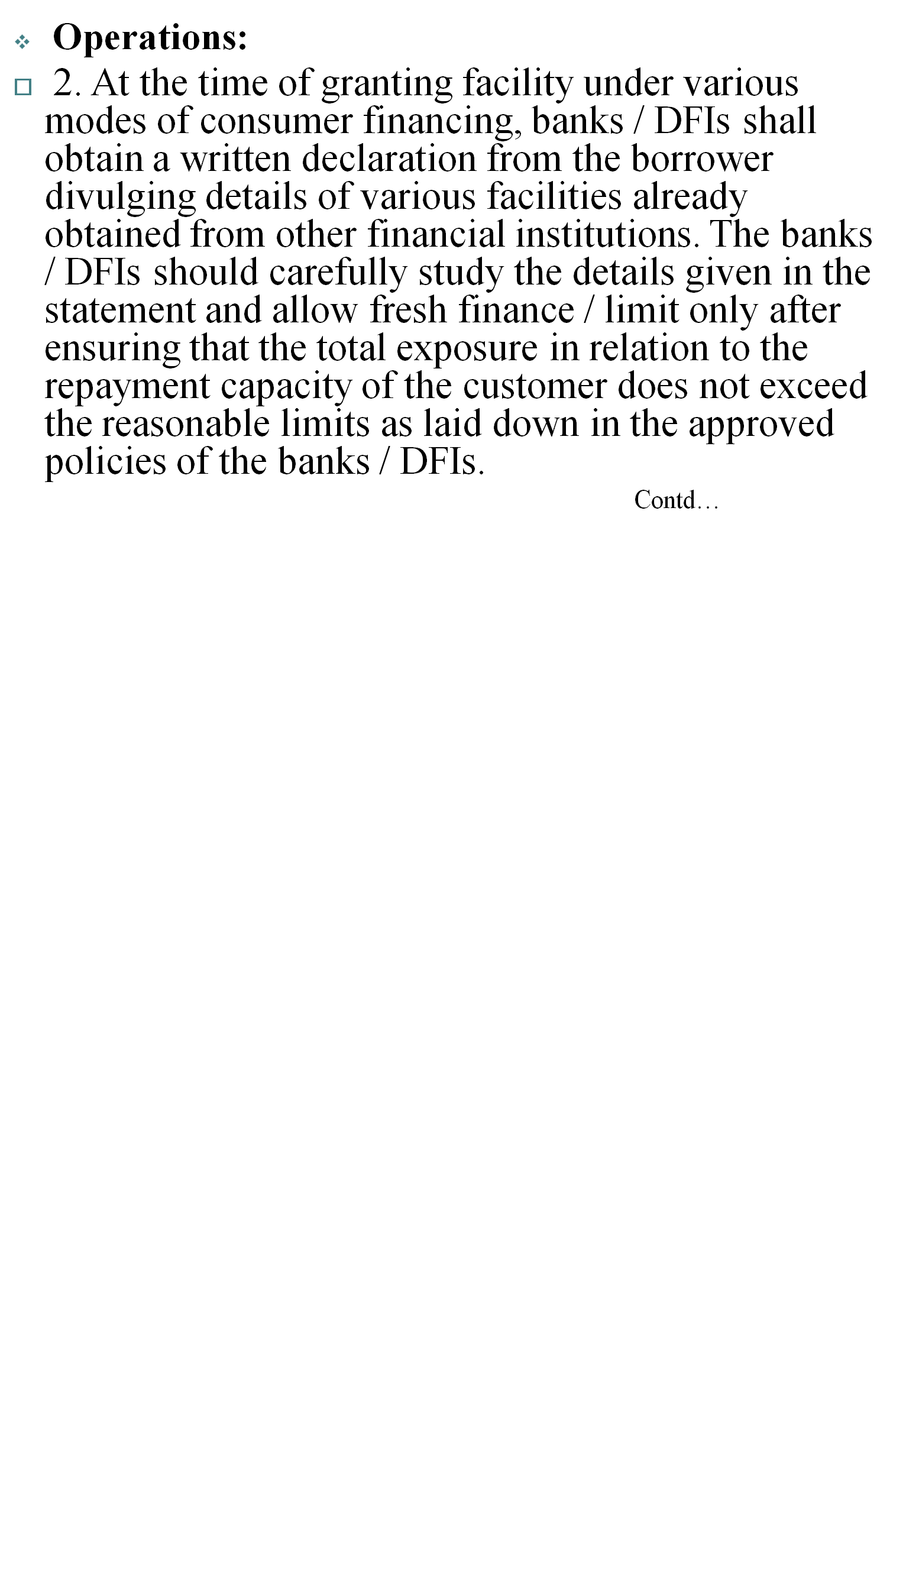

Slide 41
Operations:
2.
The declaration will also help banks / DFIs to avoid exposure against a person having multiple facilities from different financial institutions on the strength of an individual source of repayment.

Slide 42
Operations:
3. Before allowing any facility, the banks / DFIs shall preferably obtain credit report from the Consumer Credit Information Bureau of which they are a member. The report will be given due weightage while making credit decision.

Slide 43
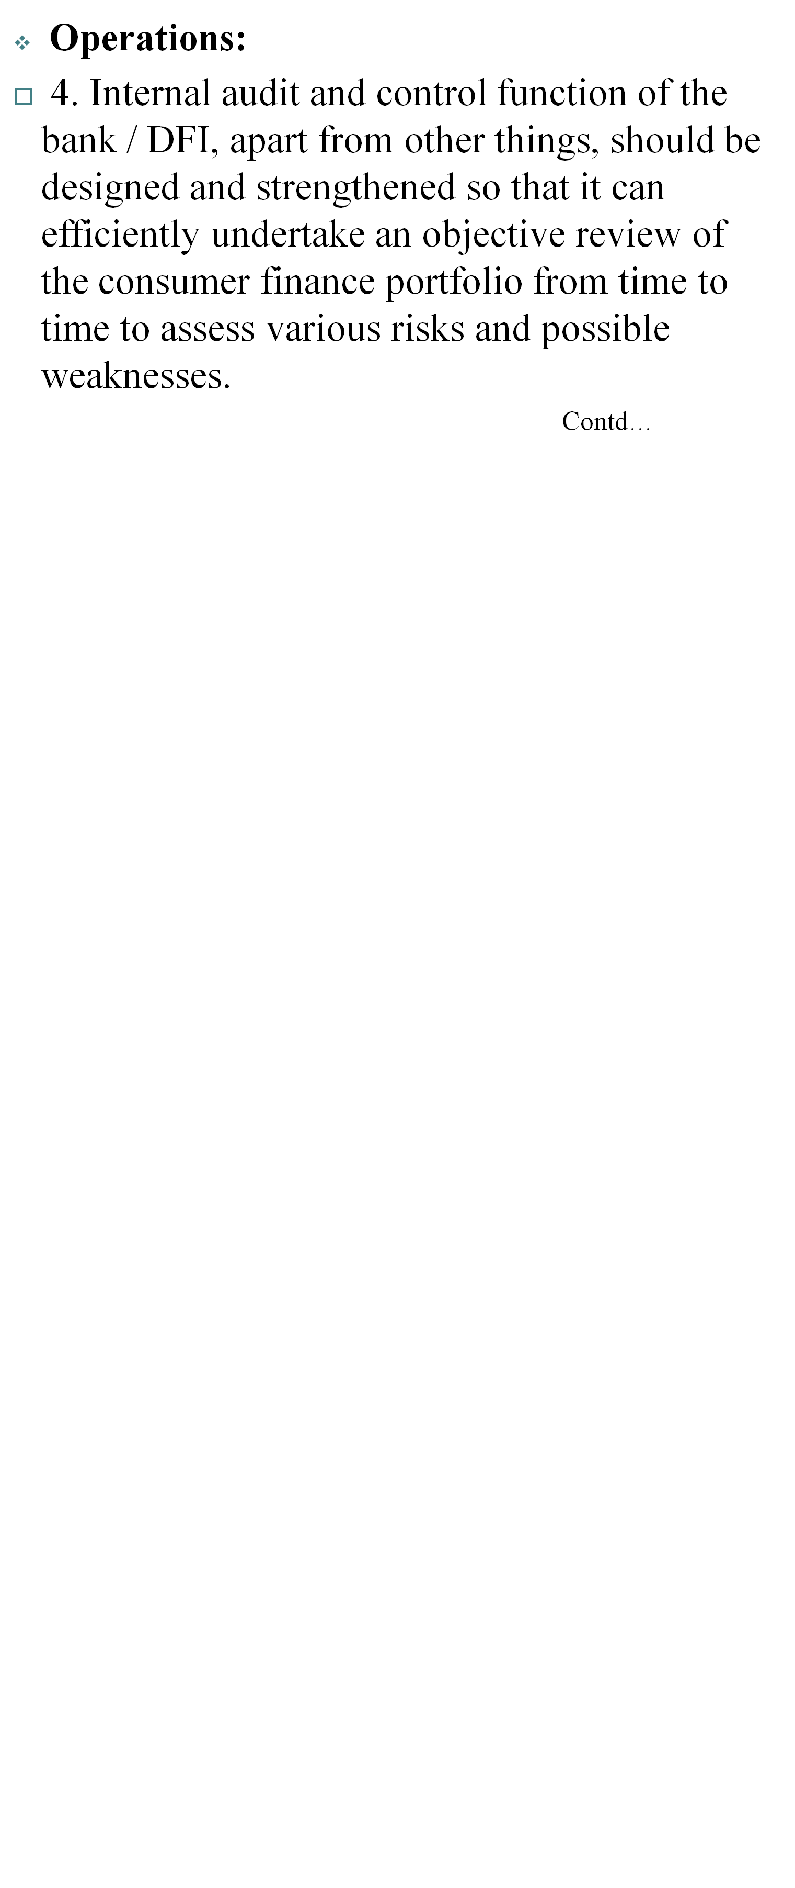

Slide 44
Operations:
4.
The internal audit should also assess the adequacy of the internal controls and ensure that the required policies and standards are developed and practiced. Internal audit should also comment on the steps taken by the management to rectify the weaknesses pointed out by them in their previous reports for reducing the level of risk.

Slide 45
Operations:
5. The banks / DFIs shall ensure that their accounting and computer systems are well equipped to avoid charging of mark-up on mark-up. For this purpose, it should be ensured that the mark-up charged on the outstanding amount is kept separate from the principal.
6. The banks / DFIs shall ensure that any repayment made by the borrower is accounted for before applying mark-up on the outstanding amount.

Slide 46


REGULATION R-1
Facilities to Related Persons and Utilization of Clean Loans for Initial Public Offerings (IPOs)

Slide 47
Facilities to Related Persons: The consumer finance facilities extended by banks / DFIs to their directors, major shareholders, employees and family members of these persons shall be at arms length basis and on normal terms and conditions applicable for other customers of the banks / DFIs. The banks / DFIs shall ensure that the appraisal standards are not compromised in such cases and market rates are used for these persons. The facilities extended to the employees of the banks / DFIs as a part of their compensation package under Employees Service Rules shall not fall in this category.

Slide 48
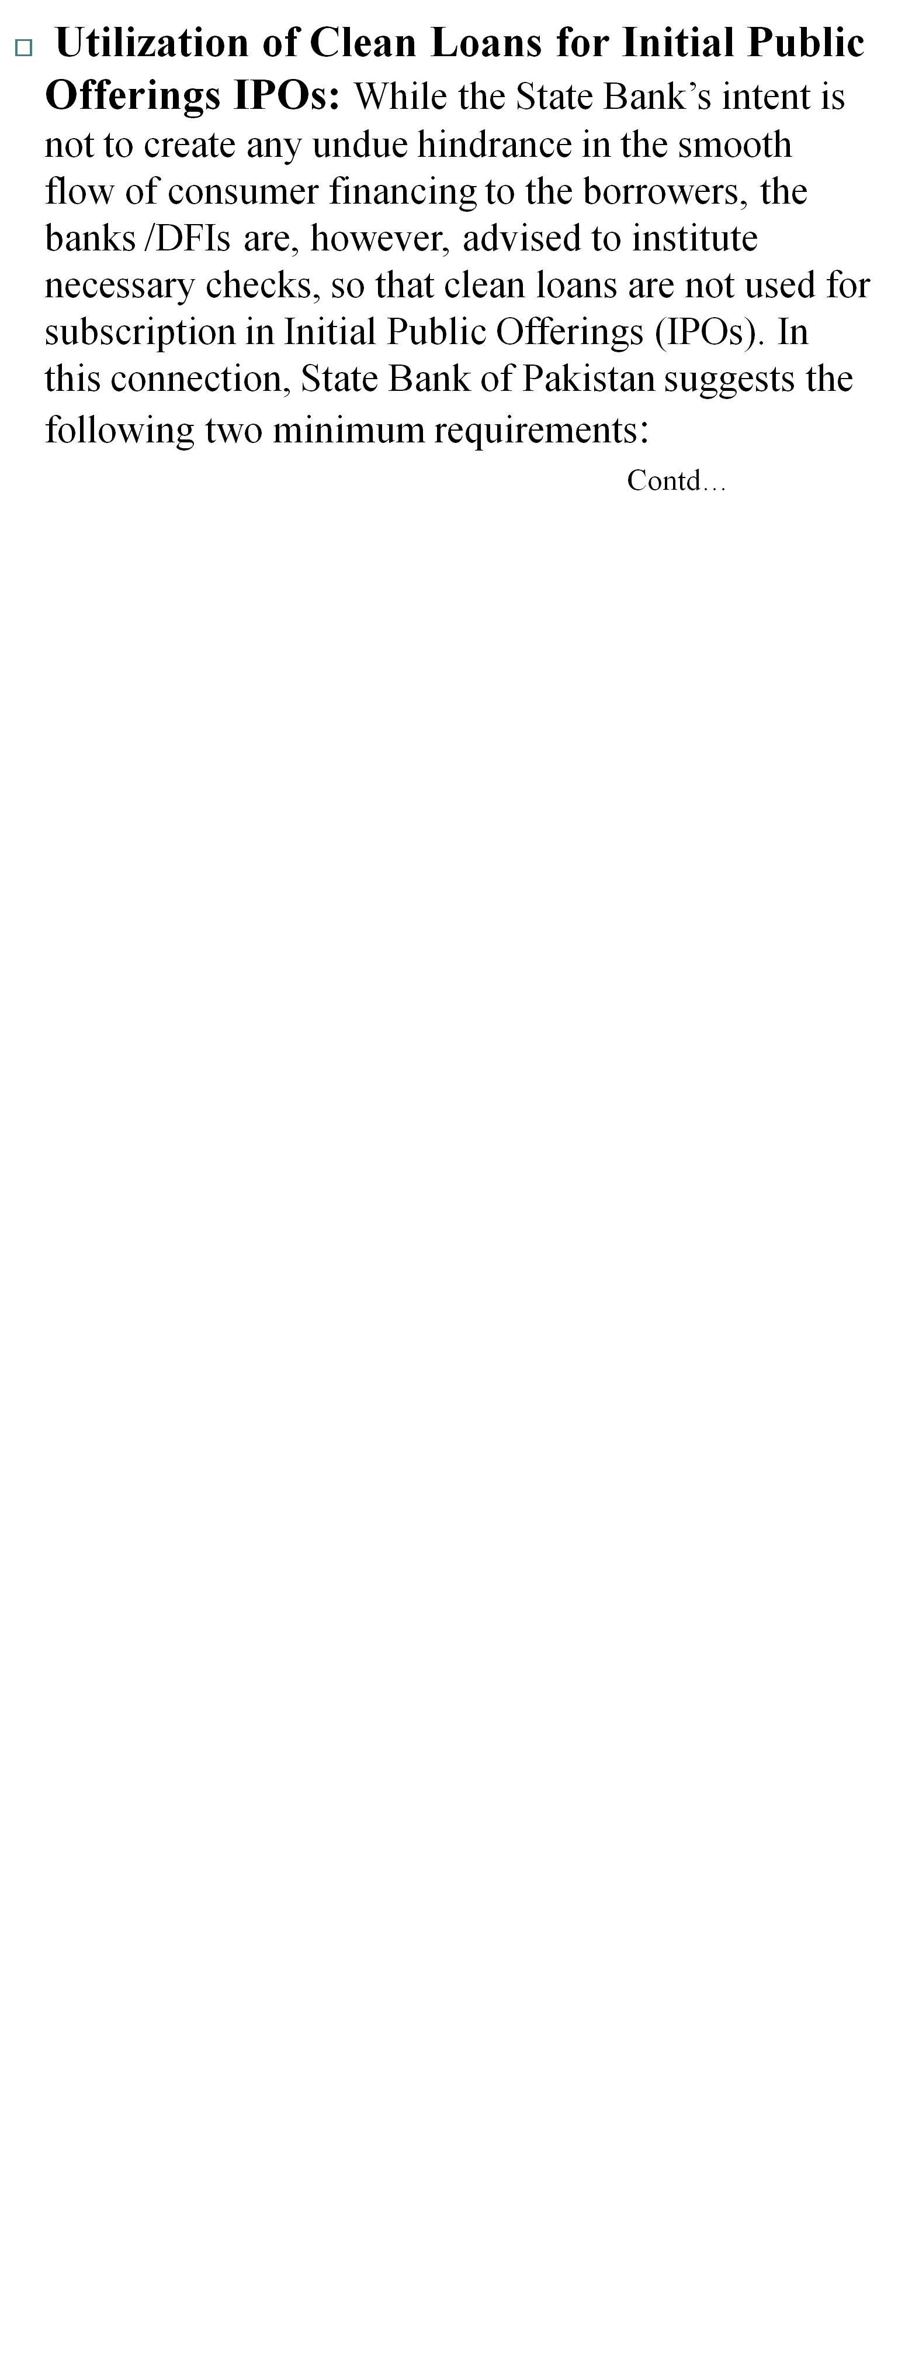

Slide 49
Utilization of Clean Loans for Initial Public Offerings IPOs:
(a) At the time of sanction of a clean consumer loan / credit line, the banks / DFIs should obtain an undertaking from the client, that the drawings from the loan account will not be used for subscription in an IPO.
(b) The banks / DFIs should introduce an internal system, whereby, no cheques, drafts and / or payment instructions will be made for an IPO subscription account from a clean personal loan / credit line account.

Slide 50
REGULATION R-2
LIMIT ON EXPOSURE AGAINST
TOTAL CONSUMER FINANCING

Slide 51
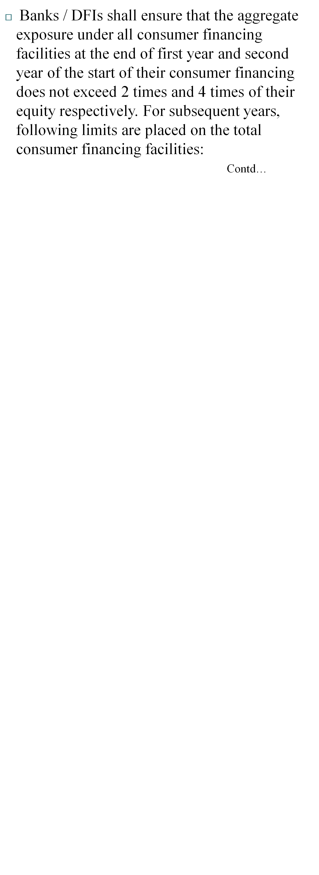

Slide 52
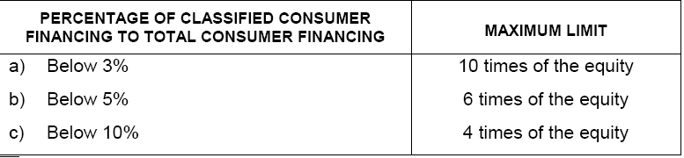

Slide 53
REGULATION R-3
TOTAL FINANCING FACILITIES TO BE
COMMENSURATE WITH THE INCOME

Slide 54
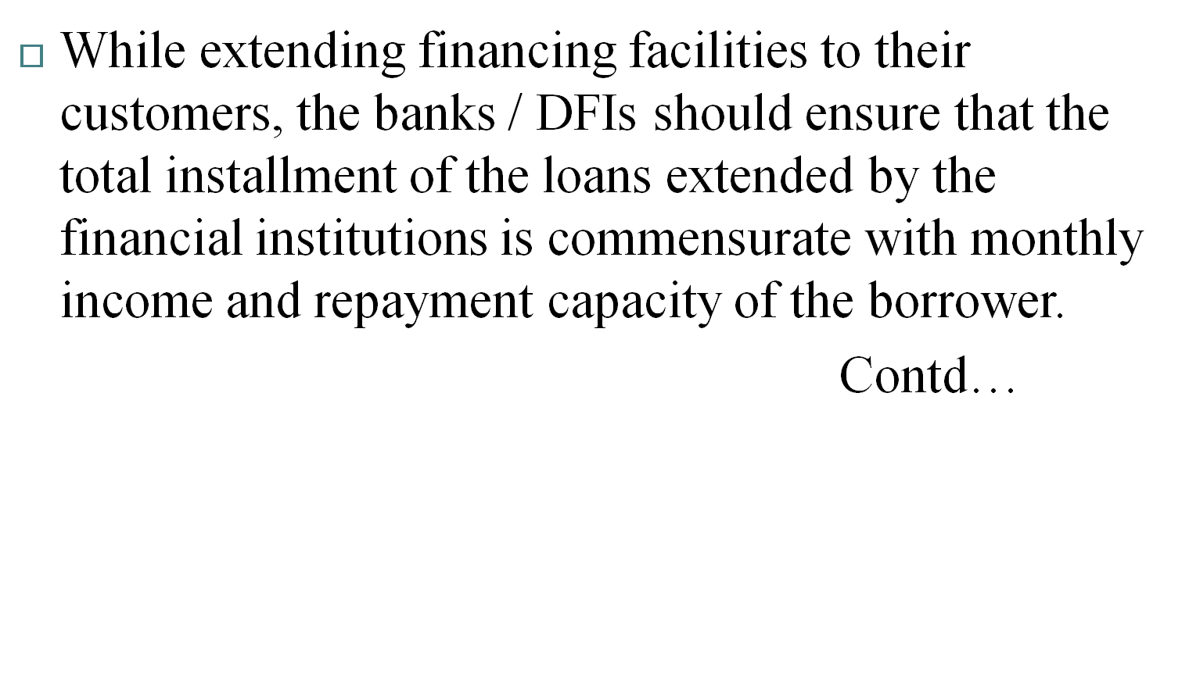

Slide 55
This measure would be in addition to banks’ / DFIs’ usual evaluations of each proposal concerning credit worthiness of the borrowers, to ensure that the banks’ / DFIs’ portfolio under consumer finance fulfills the prudential norms and instructions issued by the State Bank of Pakistan and does not impair the soundness and safety of the bank / DFI itself.

Slide 56
REGULATION R-4
GENERAL RESERVE AGAINST CONSUMER FINANCE

Slide 57
The banks / DFIs shall maintain a general reserve at least equivalent to 1.5% of the consumer portfolio which is fully secured and 5% of the consumer portfolio which is unsecured, to protect them from the risks associated with the economic cyclical nature of this business.
The above reserve requirement will, however, be maintained for the performing portion only of consumer portfolio.

Slide 58
REGULATION R-5
BAR ON TRANSFER OF FACILITIES FROM ONE CATEGORY TO ANOTHER TO AVOID CLASSIFICATION

Slide 59
The banks / DFIs shall not transfer any loan or facility to be classified, from one category of consumer finance to another, to avoid classification.

Slide 60
REGULATION R-6
MARGIN REQUIREMENTS

Slide 61
Banks / DFIs are free to determine the margin requirements on consumer facilities provided by them to their clients taking into account the risk profile of the borrower(s) in order to secure their interests. However, this relaxation shall not apply in case of items, import of which are banned by the Government.

Slide 62
Banks / DFIs will continue to observe margin restrictions on shares / TFCs as per existing instructions under Prudential Regulations for Corporate / Commercial Banking (R-6). Further, the restrictions prescribed under paragraph 1.A of Regulation R-6 of the Prudential Regulations for Corporate / Commercial Banking will also be applicable in case of Consumer Financing.

Slide 63
State Bank of Pakistan shall continue to exercise its powers for fixation / reinstatement of margin requirements on consumer facilities being provided by banks/DFIs for various purposes, as and when required.

Slide 64
REGULATIONS FOR CREDIT CARDS

Slide 65

REGULATION O-1
The banks / DFIs should take reasonable steps to satisfy themselves that card holders have received the cards, whether personally or by mail. The banks / DFIs should advise the card holders of the need to take reasonable steps to keep the card safe and the PIN secret so that frauds are avoided.

Slide 66
REGULATION O-2
Banks / DFIs shall provide to the credit card holders, the statement of account at monthly intervals, unless there has been no transaction or no outstanding balance on the account since last statement.

Slide 67
REGULATION O-3
Banks / DFIs shall be liable for all transactions not authorized by the credit card holders after they have been properly served with a notice that the card has been lost / stolen. However, the bank’s / DFI’s liability shall be limited to those amounts wrongly charged to the credit card holder’s account. In order to mitigate the risks in this respect, the banks / DFIs are encouraged to take insurance cover against wrongly charged amounts, frauds, etc.

Slide 68
REGULATION O-3
The bank/DFI shall, however, not charge the borrowers’ account with any amount under the head of “insurance premium” (by whatsoever name called) without obtaining consent of each existing & prospective customer in writing. In addition to obtaining consent in writing, the banks/DFIs may also use the following modes for obtaining prior consent of their customers provided proper record is maintained by banks/DFIs:-
Contd…

Slide 69
REGULATION O-3
i) Customer’s consent on recorded lines via out bound/in bound call center (after due verification)
ii) ATM screens – screen pop up before conducting transaction and after inputting pin code
iii) Signed consent acquired with credit card application or as separate form
iv) IVR (Integrated Voice Recording)

Slide 70
REGULATION O-4
In case the cardholders make partial payment, the banks / DFIs should take into account the partial payment before charging service fee / mark-up amount on the outstanding / billed amount so that the possibility of charging excess amount of mark-up could be avoided.

Slide 71
REGULATION O-5
Due date for payment must be specifically mentioned on the accounts statement. If fine / penalty is agreed to be charged in case the payment is not made by the due date, it should be clearly mentioned in the agreement.

Slide 72

REGULATION R-7
MAXIMUM CARD LIMIT
Maximum unsecured limit under credit card to a borrower (supplementary cards shall be considered part of the principal borrower) shall generally not exceed Rs 500,000/.

Slide 73
REGULATION R-7
MAXIMUM CARD LIMIT
Banks / DFIs may, however, assign a clean limit beyond Rs 500,000 but not in excess of Rs 2 million to their prime customers who have extraordinary strong repayment capacity, moderate debt burden and a clean track record.

Slide 74
REGULATION R-7
MAXIMUM CARD LIMIT
But the aggregate outstanding in this respect should not exceed 10% of the total outstanding credit card portfolio at any point in time. However, while availing benefit of this provision, banks / DFIs would place on record well defined criteria for terms "Prime Customers" and "Moderate Debt Burden" approved by their Board of Directors / Chief Executive.

Slide 75
REGULATION R-7
MAXIMUM CARD LIMIT
Banks / DFIs may also allow financing under the credit card scheme in excess of Rs 500,000/- (up to Rs 2 million) to other customers as well, provided the excess amount is appropriately secured according to the definition given in Part A of these regulations.

Slide 76
REGULATION R-7
MAXIMUM CARD LIMIT
The loan secured against liquid securities shall, however, be exempted from the above limit.
The loans against the securities issued by Central Directorate of National Savings (CDNS) shall be subject to such limits as are prescribed by CDNS / Federal Government / State Bank of Pakistan from time to time.

Slide 77
REGULATION R-7
MAXIMUM CARD LIMIT
For Charge Cards, pre-set spending limits generated by the standardized systems, as is the global practice, shall be allowed.

Slide 78
REGULATION R-8
CLASSIFICATION AND PROVISIONING
The credit card advances shall be classified and provided for in the following manner:
Contd….

Slide 79

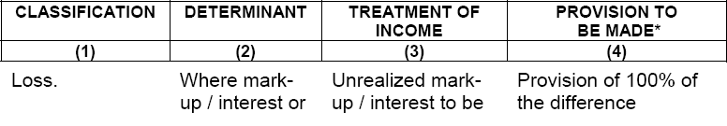
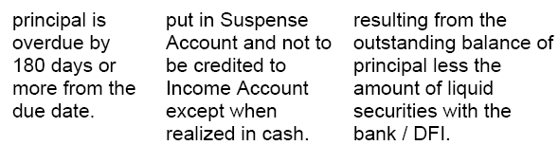

Slide 80
REGULATION R-8
CLASSIFICATION AND PROVISIONING
It is clarified that the lenders are allowed to follow more conservative policies. Further, provisioning may be created and maintained by the bank / DFI on a portfolio basis provided that the provision maintained by the bank / DFI shall not be less than the level required under this Regulation.

Slide 81
REGULATIONS FOR AUTO LOANS
R-9 to R- 13, O-6 to O-9 & R-14 Classifications

Slide 82

REGULATION R-9
The vehicles to be utilized for commercial purposes shall not be covered under the Prudential Regulations for Consumer Financing. Any such financing shall ensure compliance with Prudential Regulations for Corporate / Commercial Banking or Prudential Regulations for SMEs Financing. These regulations shall only apply for financing vehicles for personal use including light commercial vehicles also used for personal purposes.

Slide 83
REGULATION R-10
The maximum tenure of the auto loan finance shall not exceed seven years.

Slide 84
REGULATION R-11
While allowing auto loans, the banks / DFIs shall ensure that the minimum down payment does not fall below 10% of the value of vehicle. Further, banks / DFIs shall extend auto loans only for the ex-factory tax paid price fixed by the car manufacturers. In other words, banks / DFIs cannot finance the premium charged by the dealers and / or investors over and above the ex-factory tax paid price of cars, fixed by the manufacturers.

Slide 85
REGULATION R-12
In addition to any other security arrangement on the discretion of the banks/ DFIs, the vehicles financed by the banks / DFIs shall be properly secured by way of hypothecation. Payments against the sale orders issued by the manufacturers are allowed till the time of delivery of the vehicle subject to the condition that payment will directly be made to the manufacturer / authorized dealer by the bank/ DFI and upon delivery, the vehicle will immediately be hypothecated to the bank/ DFI.

Slide 86
REGULATION R-13
The banks / DFIs shall ensure that the vehicle remains properly insured at all times during the tenure of the loan.

Slide 87
REGULATION O-6
The clause of repossession in case of default should be clearly stated in the loan agreement mentioning specific default period after which the repossession can be initiated. The repossession expenses charged to the borrower shall not be more than actual incurred by the bank / DFI.

Slide 88
REGULATION O-6
However, the maximum amount of repossession charges shall be listed in the schedule of charges provided to customers. The banks / DFIs shall develop an appropriate procedure for repossession of the vehicles and shall ensure that the procedure is strictly in accordance with law.

Slide 89
REGULATION O-7
A detailed repayment schedule should be provided to the borrower at the outset. Where alterations become imminent because of late payments or prepayments and the installment amount or period changes significantly, the revised schedule should be provided to the borrower at the earliest convenience of the bank / DFI but not later than 15 days of the change.

Slide 90
REGULATION O-7
Further, even in case of insignificant changes, upon the request of the customer, the bank / DFI shall provide him revised repayment schedule free of cost.

Slide 91
REGULATION O-8
The banks / DFIs desirous of financing the purchase of used cars shall prepare uniform guidelines for determining the value of the used vehicles. However, in no case the bank / DFI shall finance the cars older than five years.

Slide 92
REGULATION O-9
The banks / DFIs should ensure that a good number of authorized auto dealers are placed at their panel to eliminate the chances of collusion or other unethical practices.

Slide 93
REGULATION R-14- Classifications
The auto loans shall be classified and provided for in the following manner:
Contd….

Slide 94
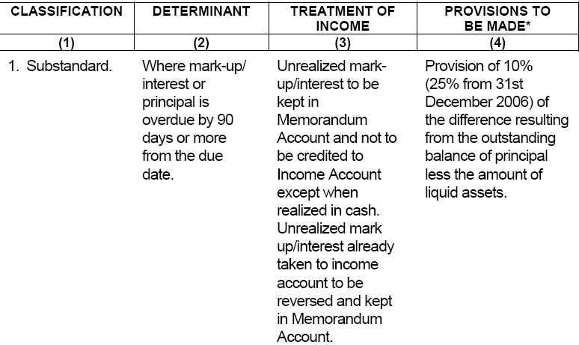

Slide 95
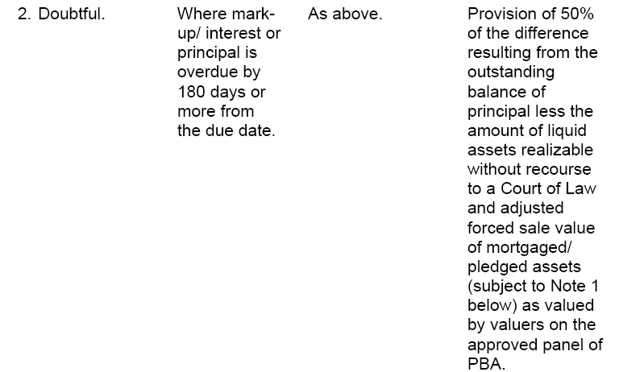

Slide 96
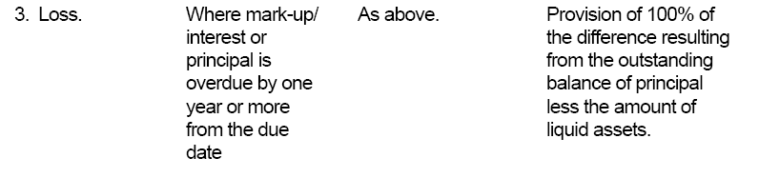

Slide 97
REGULATIONS FOR HOUSING FINANCE– R-15 to R-21, & R-22 Classifications

Slide 98
REGULATION R-15
Banks / DFIs shall determine the housing finance limit, both in urban and rural areas, in accordance with their internal credit policy, credit worthiness and loan repayment capacity of the borrowers. At the same time, while determining the credit worthiness and repayment capacity of the prospective borrower, banks / DFIs shall ensure that the total monthly amortization payments of consumer loans, inclusive of housing loan, should not exceed 50% of the net disposable income of the prospective borrower.

Slide 99
REGULATION R-15
Banks / DFIs will not allow housing finance purely for the purchase of land / plots; rather, such financing would be extended for the purchase of land / plot and construction on it.

Slide 100
REGULATION R-15
Accordingly, the sanctioned loan limit, assessed on the basis of repayment capacity of the borrower, value of land / plot and cost of construction on it etc., should be disbursed in tranches, i.e. up to a maximum of 50% of the loan limit can be disbursed for the purchase of land/ plot, and the remaining amount be disbursed for construction there-upon.

Slide 101
REGULATION R-15
Further, the lending bank / DFI will take a realistic construction schedule from the borrower before allowing disbursement of the initial loan limit for the purchase of land / plot.

Slide 102
REGULATION R-15
Banks / DFIs may allow housing finance facility for construction of houses against the security of land / plot already owned by their customers. However, the lending bank / DFI will ensure that the loan amount is utilized strictly for the construction purpose and loan is disbursed in tranches as per construction schedule.

Slide 103
REGULATION R-15
Loans against the security of existing land / plot, or for the purchase of new piece of land / plot, for commercial and industrial purposes may be allowed. But such loans will be treated as Commercial Loans, which will be covered either under Prudential Regulations for Corporate / Commercial Banking or Prudential Regulations for SMEs Financing.
Banks / DFIs may allow Housing Loans in the rural areas provided all relevant guidelines/regulations on the subject are complied with by them.

Slide 104
REGULATIONS FOR HOUSING FINANCE– R-15 to R-21, & R-22 Classifications

Slide 105

REGULATION R-15
Banks / DFIs shall determine the housing finance limit, both in urban and rural areas, in accordance with their internal credit policy, credit worthiness and loan repayment capacity of the borrowers. At the same time, while determining the credit worthiness and repayment capacity of the prospective borrower, banks / DFIs shall ensure that the total monthly amortization payments of consumer loans, inclusive of housing loan, should not exceed 50% of the net disposable income of the prospective borrower.

Slide 106

REGULATION R-15
Banks / DFIs will not allow housing finance purely for the purchase of land / plots; rather, such financing would be extended for the purchase of land / plot and construction on it.

Slide 107
REGULATION R-15
Accordingly, the sanctioned loan limit, assessed on the basis of repayment capacity of the borrower, value of land / plot and cost of construction on it etc., should be disbursed in tranches, i.e. up to a maximum of 50% of the loan limit can be disbursed for the purchase of land/ plot, and the remaining amount be disbursed for construction there-upon.

Slide 108

REGULATION R-15
Further, the lending bank / DFI will take a realistic construction schedule from the borrower before allowing disbursement of the initial loan limit for the purchase of land / plot.

Slide 109
REGULATION R-15
Banks / DFIs may allow housing finance facility for construction of houses against the security of land / plot already owned by their customers. However, the lending bank / DFI will ensure that the loan amount is utilized strictly for the construction purpose and loan is disbursed in tranches as per construction schedule.

Slide 110
REGULATION R-15
Loans against the security of existing land / plot, or for the purchase of new piece of land / plot, for commercial and industrial purposes may be allowed. But such loans will be treated as Commercial Loans, which will be covered either under Prudential Regulations for Corporate / Commercial Banking or Prudential Regulations for SMEs Financing.
Banks / DFIs may allow Housing Loans in the rural areas provided all relevant guidelines/regulations on the subject are complied with by them.

Slide 111
REGULATION R-16
The housing finance facility shall be provided at a maximum debt-equity ratio of 85:15
REGULATION R-17
Banks / DFIs are free to extend mortgage loans for housing, for a period not exceeding twenty years. Banks / DFIs should be mindful of adequate asset - liability matching.

Slide 112
REGULATION R-18
The house financed by the bank / DFI shall be mortgaged in bank’s / DFI’s favour by way of equitable or registered mortgage.

Slide 113
REGULATION R-19
Banks / DFIs shall either engage professional expertise or arrange sufficient training for their concerned officials to evaluate the property, assess the genuineness and integrity of the title documents, etc.

Slide 114
REGULATION R-19
It may, however, be noted that the requirement of full-scope and desk-top evaluation, as required under R-8 and R-11 of Prudential Regulations for Corporate / Commercial Banking and SMEs Financing respectively, will not be applicable on housing finance.

Slide 115
REGULATION R-20
The bank’s / DFI’s management should put in place a mechanism to monitor conditions in the real estate market (or other product market) at least on quarterly basis to ensure that its policies are aligned to current market conditions.

Slide 116
REGULATION R-21
Banks / DFIs are encouraged to develop floating rate products for extending housing finance, thereby managing interest rate risk to avoid its adverse effects. Banks / DFIs are also encouraged to develop in-house system to stress test their housing portfolio against adverse movements in interest rates as also maturity mismatches.

Slide 117
REGULATION R-22
The mortgage loans shall be classified and provided for in the following manner:
      Contd…

Slide 118
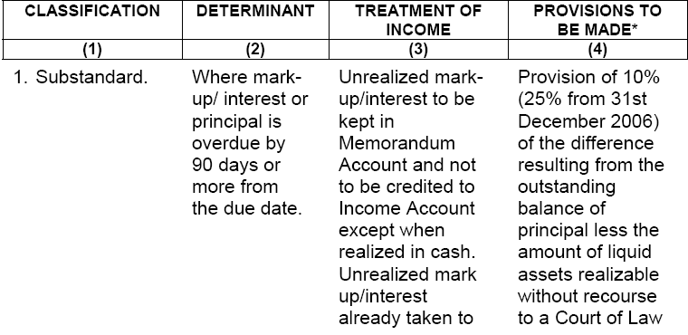
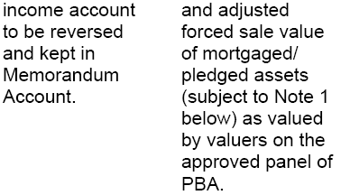

Slide 120
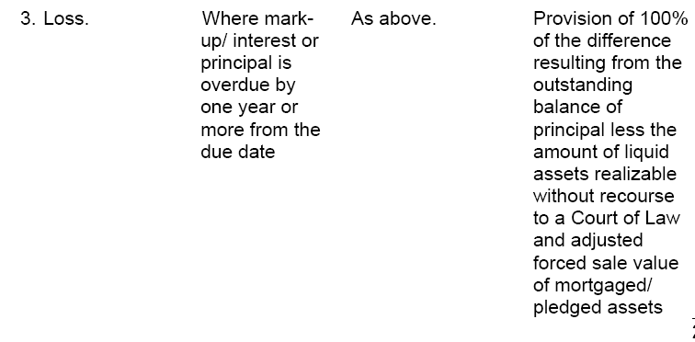

Slide 121
REGULATIONS FOR PERSONAL LOANS INCLUDING
LOANS FOR THE PURCHASE OF CONSUMER DURABLES- R-23 to R-27

Slide 122

REGULATION R-23
The clean limit per person for personal loans will generally not exceed Rs 500,000/-.
Banks / DFIs may assign a clean limit beyond Rs 500,000 but not in excess of Rs 2 million to their prime customers who have extraordinary strong repayment capacity, moderate debt burden and a clean track record. But aggregate outstanding in this respect should not exceed 10% of the total outstanding personal loans at any point in time

Slide 123

REGULATION R-23
However, while availing benefit of this provision, banks / DFIs would place on record well defined criteria for terms "Prime Customers" and "Moderate Debt Burden" approved by their Board of Directors / Chief Executive.

Slide 124
REGULATION R-23
Banks / DFIs may also allow financing under Personal Loans in excess of Rs 500,000 (up to Rs. 1,000,000) to other customers as well, provided the loan is appropriately secured according to the definition given in Part A of these regulations.
The loan secured against liquid securities shall, however, be exempted from this limit.

Slide 125
REGULATION R-23
The loans against the securities issued by Central Directorate of National Savings (CDNS) shall be subject to such limits as are prescribed by CDNS / Federal Government / State Bank of Pakistan from time to time.

Slide 126
REGULATION R-24
In cases, where the loan has been extended to purchase some durable goods / items, including personal computers and accessories thereof, the same will be hypothecated with the bank / DFI besides other securities, which the bank / DFI may require on its own.

Slide 127

REGULATION R-25
The maximum tenure of the loan shall not exceed 5 years. However, this period may be extended to 7 years for loans / advances given for educational purposes, provided that disbursement of such loans shall directly be made by the bank / DFI to the educational institution and the borrower shall not be allowed to utilize / withdraw cash directly from the bank / DFI under this head for any other purpose.

Slide 128
REGULATION R-25
The maximum tenure of the loan shall not exceed 5 years. However, this period may be extended to 7 years for loans / advances given for educational purposes, provided that disbursement of such loans shall directly be made by the bank / DFI to the educational institution and the borrower shall not be allowed to utilize / withdraw cash directly from the bank / DFI under this head for any other purpose.

Slide 129
REGULATION R-26
In case of Running Finance / Revolving Finance, it shall be ensured that at least 15% of the maximum utilization of the loan during the year is cleaned up by the borrower for a minimum period of one week. In case the clean up is not made by the borrower, the loan will be appropriately classified.

Slide 130
REGULATION R-26
However, banks / DFIs who require their customers to repay a minimum amount each month, will be considered compliant with this regulation subject to the condition that the aggregate cumulative monthly installments exceed the 15% clean up requirement and accordingly the loans where the specified minimum repayments are being made by the borrowers regularly, will not require classification under this regulation.

Slide 131
REGULATION R-27
The personal loans shall be classified and provided for in the following manner:
      Contd….

Slide 132
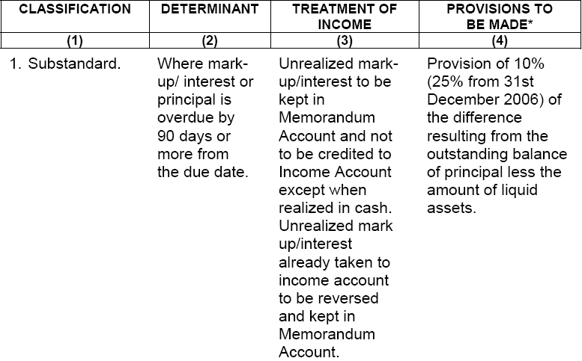

Slide 133
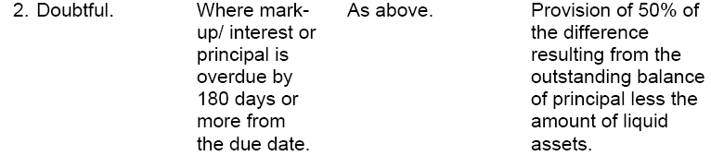

Slide 135
PRUDENTIAL REGULATIONS
FOR SMALL AND MEDIUM ENTERPRISES FINANCING

Slide 136

Definitions:
Bank means a banking company as defined in Banking Companies Ordinance, 1962.
Borrower means a SME on which a bank / DFI has taken any exposure during the course of business.
Corporate Card means credit card issued to the employees of a SME where the repayment is to be made by the said SME.

Slide 137
Definitions:
Contingent liability means:
(a) a possible obligation that arises from past events and whose existence will be confirmed only by the occurrence or non- occurrence of one or more uncertain future events not wholly within the control of the enterprise; or Contd…

Slide 138
Definitions:
Contingent liability means:
(b) a present obligation that arises from past events but is not recognized because:
(i) it is not probable that an outflow of resources embodying economic benefits will be required to settle the obligation; or
(ii) the amount of the obligation cannot be measured with sufficient reliability;

Slide 139
Definitions:
Contingent liability means:
and includes letters of credit, letters of guarantee, bid bonds / performance bonds, advance payment guarantees and underwriting commitments.

Slide 140
Definitions:
Bank means a banking company as defined in Banking Companies Ordinance, 1962.
Borrower means a SME on which a bank / DFI has taken any exposure during the course of business.
Corporate Card means credit card issued to the employees of a SME where the repayment is to be made by the said SME.

Slide 141
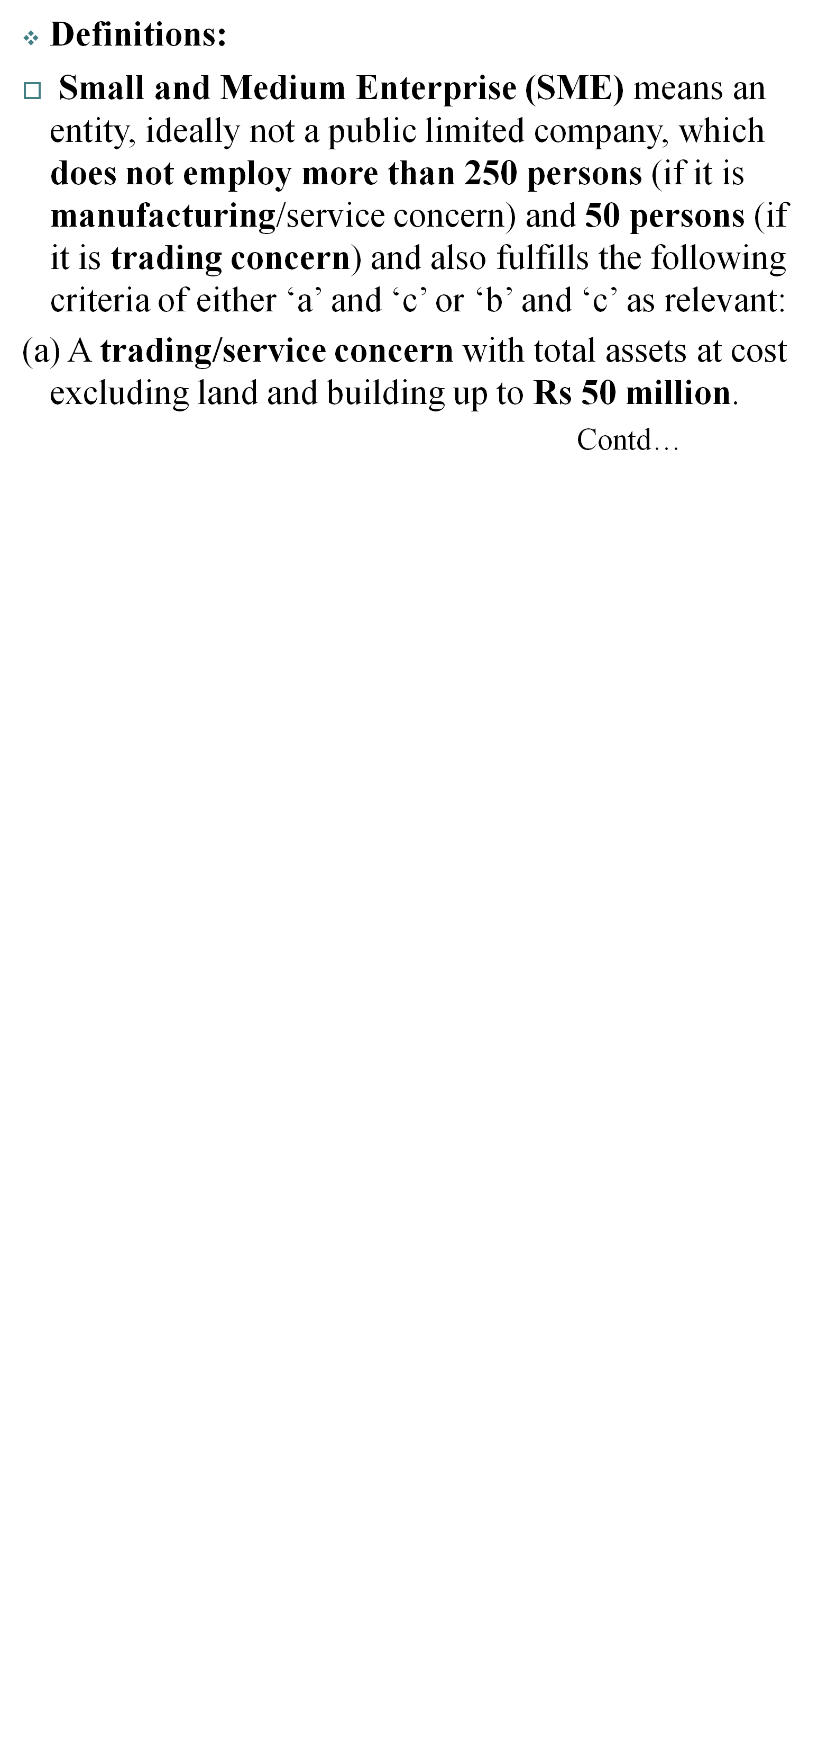

Slide 142
Definitions:
Small and Medium Enterprise (SME)
(b) A manufacturing concern with total assets at cost excluding land and building upto Rs 100 million.
(c) Any concern (trading, service or manufacturing) with net sales not exceeding Rs 300 million as per latest financial statements.
--An Individual, if he or she meets the above criteria, can also be categorized as an SME.

Slide 143

REGULATION R-1
SOURCE AND CAPACITY OF REPAYMENT
AND CASH FLOW BACKED LENDING

Slide 144
REGULATION R-2
PERSONAL GUARANTEES

Slide 145
REGULATION R-3
LIMIT ON CLEAN FACILITIES

Slide 146
REGULATION R-4
SECURITIES

Slide 147
REGULATION R-5
MARGIN REQUIREMENTS

Slide 148
REGULATION R-6
PER PARTY EXPOSURE LIMIT

Slide 149
REGULATION R-7
AGGREGATE EXPOSURE OF A BANK / DFI ON SME SECTOR

Slide 150
Regulation R-7
The aggregate exposure of a bank / DFI on SME sector shall not exceed the limits as specified below:
Contd….

Slide 151
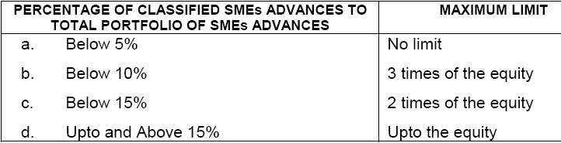
Regulation R-7

Slide 152
REGULATION R-8
MINIMUM CONDITIONS FOR TAKING EXPOSURE

Slide 153
REGULATION R-9
PROPER UTILIZATION OF LOAN

Slide 154
REGULATION R-10
RESTRICTION ON FACILITIES TO RELATED PARTIES

Slide 155
R-11
CLASSIFICATION AND PROVISIONING FOR ASSETS, As Prescribed in Annexure-111

Slide 156

Classifications

Slide 157
Classifications

Slide 158
Classifications

Slide 159


Slide 160

Definitions

Slide 161
Definitions:
“Key Executive” means key executives of banks/DFIs and includes the following functional responsibilities for the present:-
(a) Any executive, acting as second to CEO including Chief Operating Officer, Deputy Managing Director or by whatever name called
(b) Chief Financial Officer / Head of Finance / Head of Accounts
(c) Head of Internal Audit
(d) Country Treasurer

Slide 162
Definitions:
“Key Executive”
(e) Head of Credit/ Risk Management
(f) Head of Operations
(g) Head of Compliance
(h) Head of Human Resource
(i) Head of Information Technology
(j) Head of Islamic Banking

Slide 163

R E G U L A T I O N S
REGULATION R-1
LIMIT ON EXPOSURE TO A SINGLE PERSON

Slide 164
REGULATION R-2
LIMIT ON EXPOSURE AGAINST CONTINGENT LIABILITIES

Slide 165
REGULATION R-3
MINIMUM CONDITIONS FOR TAKING EXPOSURE

Slide 166
REGULATION R-4
LIMIT ON EXPOSURE AGAINST
UNSECURED FINANCING FACILITIES

Slide 167
REGULATION R-5
LINKAGE BETWEEN FINANCIAL INDICATORS OF THE BORROWER AND TOTAL EXPOSURE FROM FINANCIAL INSTITUTIONS

Slide 168
REGULATION R-6
EXPOSURE AGAINST SHARES / TFCs
AND ACQUISITION OF SHARES

Slide 169
REGULATION R-7
GUARANTEES

Slide 170
REGULATION R-8
CLASSIFICATION AND PROVISIONING FOR ASSETS

Slide 171

Classifications

Slide 172
Classifications

Slide 173
Classifications

Slide 174
REGULATION R-9
ASSUMING OBLIGATIONS ON BEHALF OF NBFCs

Slide 175
Regulation R-9
Banks / DFIs shall not issue any guarantee or letter of comfort nor assume any obligation whatsoever in respect of deposits, sale of investment certificates, issue of commercial papers, or borrowings of any non-banking finance company.

Slide 176
REGULATION R-10
FACILITIES TO PRIVATE LIMITED COMPANY

Slide 177
REGULATION R-11
PAYMENT OF DIVIDEND

Slide 178
REGULATION R-12
MONITORING

Slide 179
REGULATION R-13
MARGIN REQUIREMENTS

Slide 180
REGULATION G-1
CORPORATE GOVERNANCE / BOARD
OF DIRECTORS AND MANAGEMENT

Slide 181
Regulation G-1
The following guidelines are required to be followed by banks / DFIs incorporated in Pakistan. They will also follow ‘Code of Corporate Governance’ issued by the Securities & Exchange Commission of Pakistan (SECP) so long as any provision thereof does not conflict with any provision of the Banking Companies Ordinance, 1962, Prudential Regulations and the instructions / guidelines issued by the State Bank of Pakistan.

Slide 182
Regulation G-1
Foreign banks are required to adhere to these guidelines wherever feasible and applicable. However, they need not necessarily seek approval of their Board of Directors, as stipulated below in the case of local banks / DFIs:
Contd….

Slide 183
Regulation G-1
FIT AND PROPER TEST
-- The “Fit and Proper Test” (FPT) is applicable on the sponsors (both individual & companies) who apply for a commercial banking licence, the investors acquiring strategic/controlling stake in the banks/DFIs, major shareholders of the banking companies and for the appointment of Directors, CEO, and Key Executives of the banks/DFIs. The fitness & propriety will be assessed on the following broad elements (Annexure VII-B): Contd..

Slide 184
Regulation G-1
FIT AND PROPER TEST
a. Integrity, Honesty & Reputation
b. Track Record
c. Solvency & Integrity
d. Qualification & Experience
e. Conflict of Interest
f. Others

Slide 185
Regulation G-1
FIT AND PROPER TEST
2. First three elements are applicable to all categories of individuals, whereas the last three elements will be considered while assessing the FPT of Directors, CEO & Key Executives of banks/DFIs.

Slide 186
Regulation G-1
FIT AND PROPER TEST
2. In addition to above requirements, sponsors and strategic investors are evaluated respectively in terms of “Guidelines & Criteria for setting up of a Commercial Bank” & “Criteria for Establishment of Islamic Commercial Banks” issued by SBP and Code of Corporate Governance issued by SECP.

Slide 187
Regulation G-1
FIT AND PROPER TEST
3. The sponsors, the strategic investors, and appointment of the Directors and CEO require prior clearance in writing from SBP. The CEO and Key Executives shall be full time employees of the bank/DFI. The Directors and CEO will not assume the charge of their respective offices until their appointments are approved in writing by SBP.

Slide 188
Regulation G-1
FIT AND PROPER TEST
3. All the requests for seeking approval of SBP for appointment of Directors & CEO of the banks/DFIs should be routed through respective banks/DFIs along with information on Annexures-VI-A & VI-B.

Slide 189
Regulation G-1
FIT AND PROPER TEST
4. The appointment of Key Executives will not require prior clearance of SBP. However, the banks/DFIs must themselves ensure while appointing Key Executives that they qualify FPT in letter and spirit.

Slide 190
Regulation G-1
FIT AND PROPER TEST
4. The information on appointment of Key Executive is required to be forwarded to SBP on prescribed format at Annexure-VII-A within seven days of assumption of the charge of the post by the incumbent. The information submitted may be checked on post fact basis by Banking Inspection Department of SBP during inspection.

Slide 191
Regulation G-1
FIT AND PROPER TEST
5. The sponsors are required to seek prior approval of SBP along with the information at Annexure- VI-B and other information as required in the “Guidelines & Criteria for Setting up a Commercial Bank” and” Criteria for Establishment of Islamic Commercial Banks”.

Slide 192
Regulation G-1
FIT AND PROPER TEST
5. The strategic investors contemplating to acquire strategic/controlling stake are required to seek prior approval from SBP either directly or through the concerned department/Ministry of Government executing strategic sale transaction of the bank as required and provided in the transaction structure.

Slide 193
Regulation G-1
FIT AND PROPER TEST
5. The bank should also ensure to give prior intimation to SBP before dealing with any investors/bank/institutions/person for sale/purchase of sponsors/ strategic shares and seek approval of SBP for conducting due diligence of bank/DFI in terms of BPD Circular No. 8 of 2003.

Slide 194
Regulation G-1
FIT AND PROPER TEST
6. The major shareholders are required to seek prior approval in writing from SBP for acquiring 5% or more shares along-with information on Annexure- VI-B, with proper justification for holding more than 5% shares of the paid up capital. All the banks/DFIs are required to ensure that major shareholders have sought such an approval from SBP and place it on record.

Slide 195
Regulation G-1
FIT AND PROPER TEST
7. Fit & Proper Test prescribed in the guideline is continuous in nature. All persons subject to FPT should immediately submit any change in the information already submitted (at the time of clearance) either through Company Secretary or Human Resources Department to Banking Policy and Regulations Department.

Slide 196
Regulation G-1
FIT AND PROPER TEST
7. Violation of the instructions, circumvention, concealment, misreporting and delay in submission of information to SBP may result in
withdrawal of SBP approval, besides penal action
under the provisions of BCO, 1962.

Slide 197
REGULATION G-2
DEALING WITH DIRECTORS, MAJOR SHARE-HOLDERS
AND EMPLOYEES OF THE BANKS / DFIs

Slide 198
REGULATION G-3
CONTRIBUTIONS AND DONATIONS FOR CHARITABLE, SOCIAL, EDUCATIONAL AND PUBLIC WELFARE PURPOSES

Slide 199
REGULATION G-4
CREDIT RATING

Slide 200
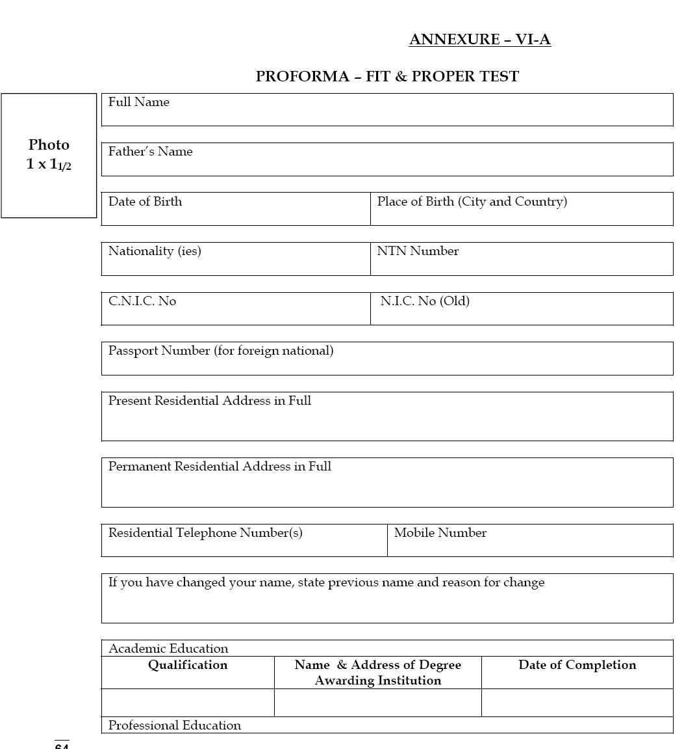

Slide 201
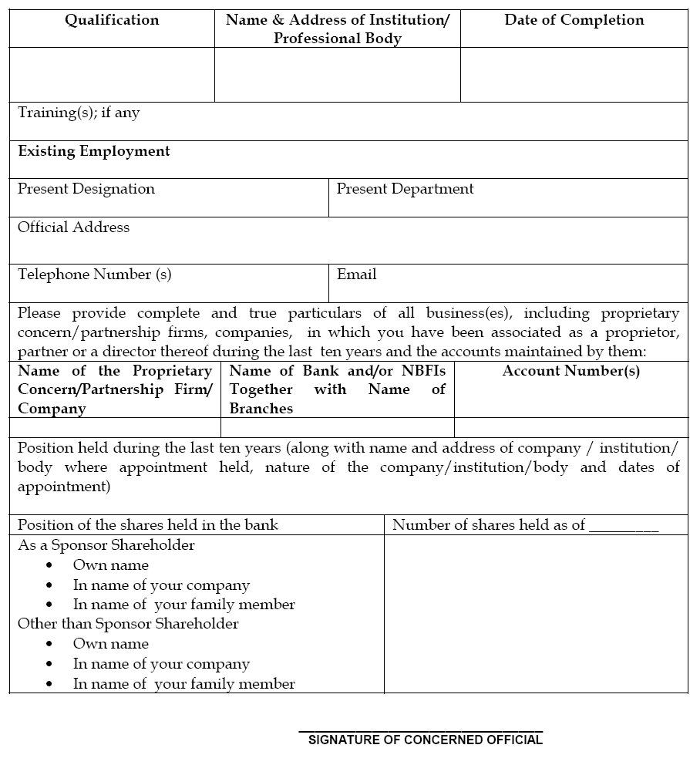

Slide 202
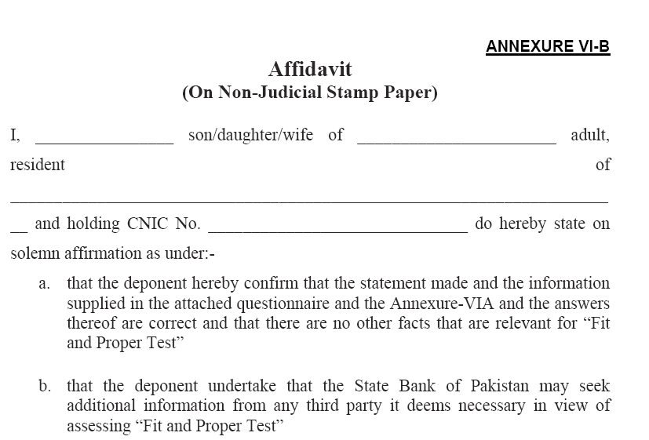

Slide 203

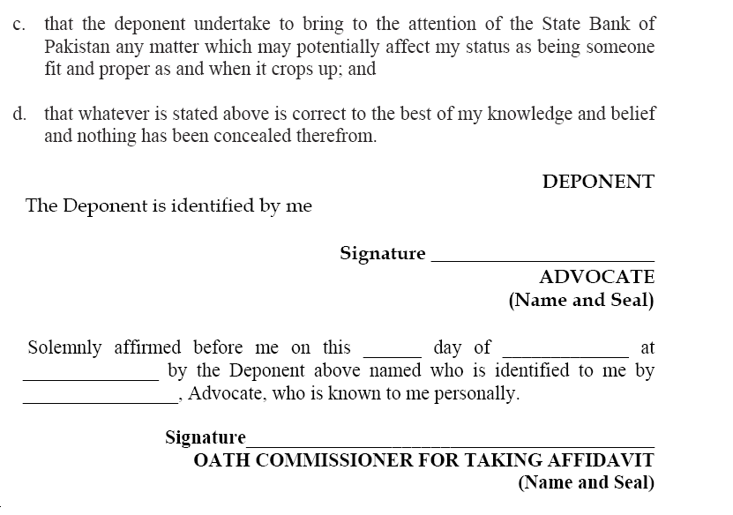

Slide 204
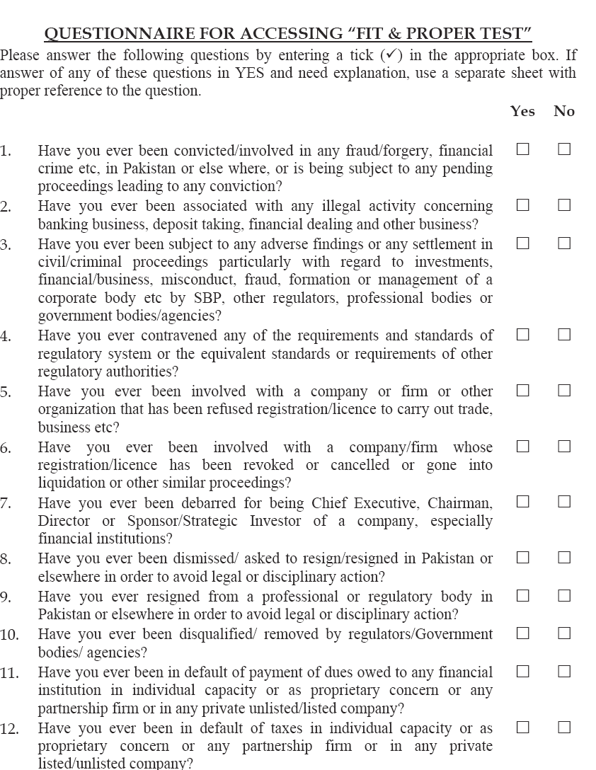

Slide 205
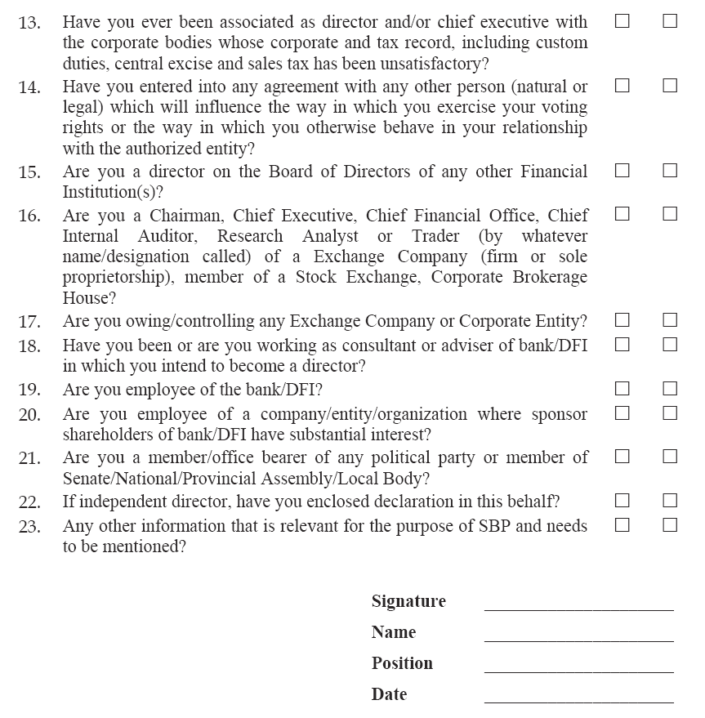

Slide 206
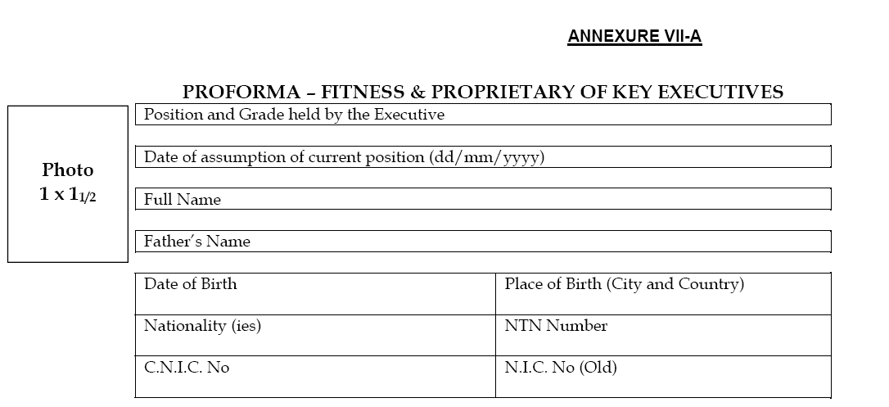

Slide 207

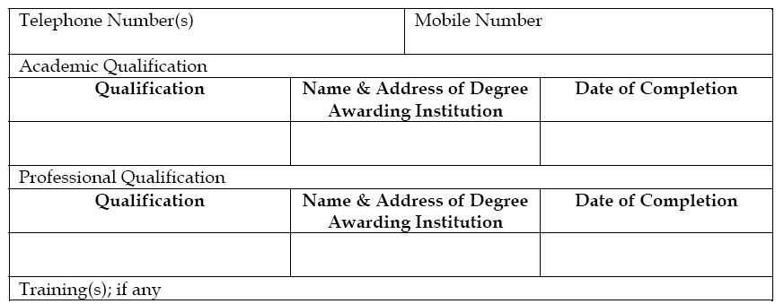

Slide 208
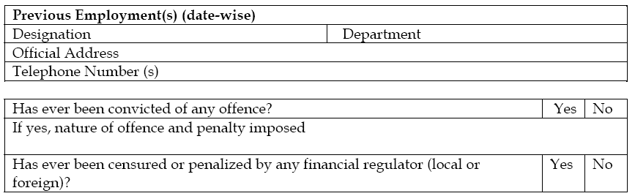

Slide 209
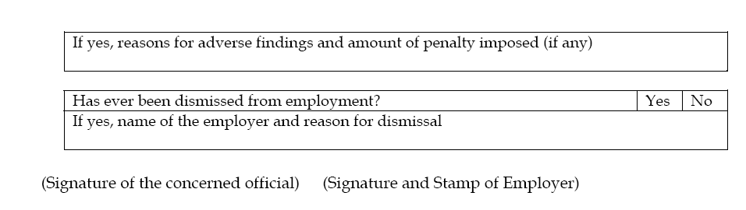

Slide 210
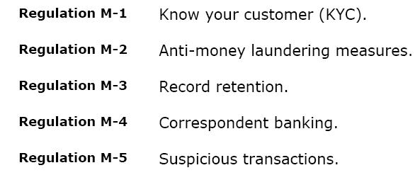

Slide 211
